Slide 1
Hydrology signature in superconducting gravimeter readings
Jiaxin Liu
Philipp Schollmeier
February 7th, 2023, Stuttgart

Slide 2
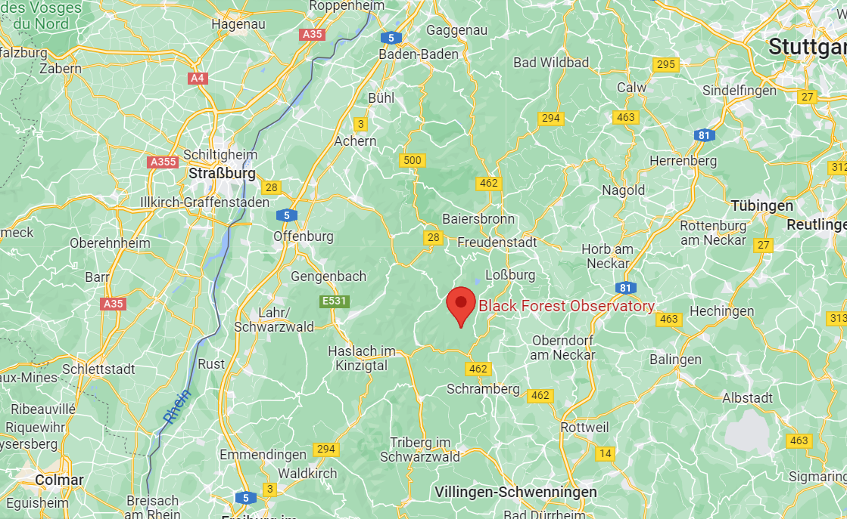
Measurement site
Fig. 1: Location of the BFO (Google Maps)
Black Forest Observatory near the village of Schiltach
Notes:
-In a remote location with few human sources of noise
-Granite bedrock -> less movement of ground with changing pressure

Slide 3
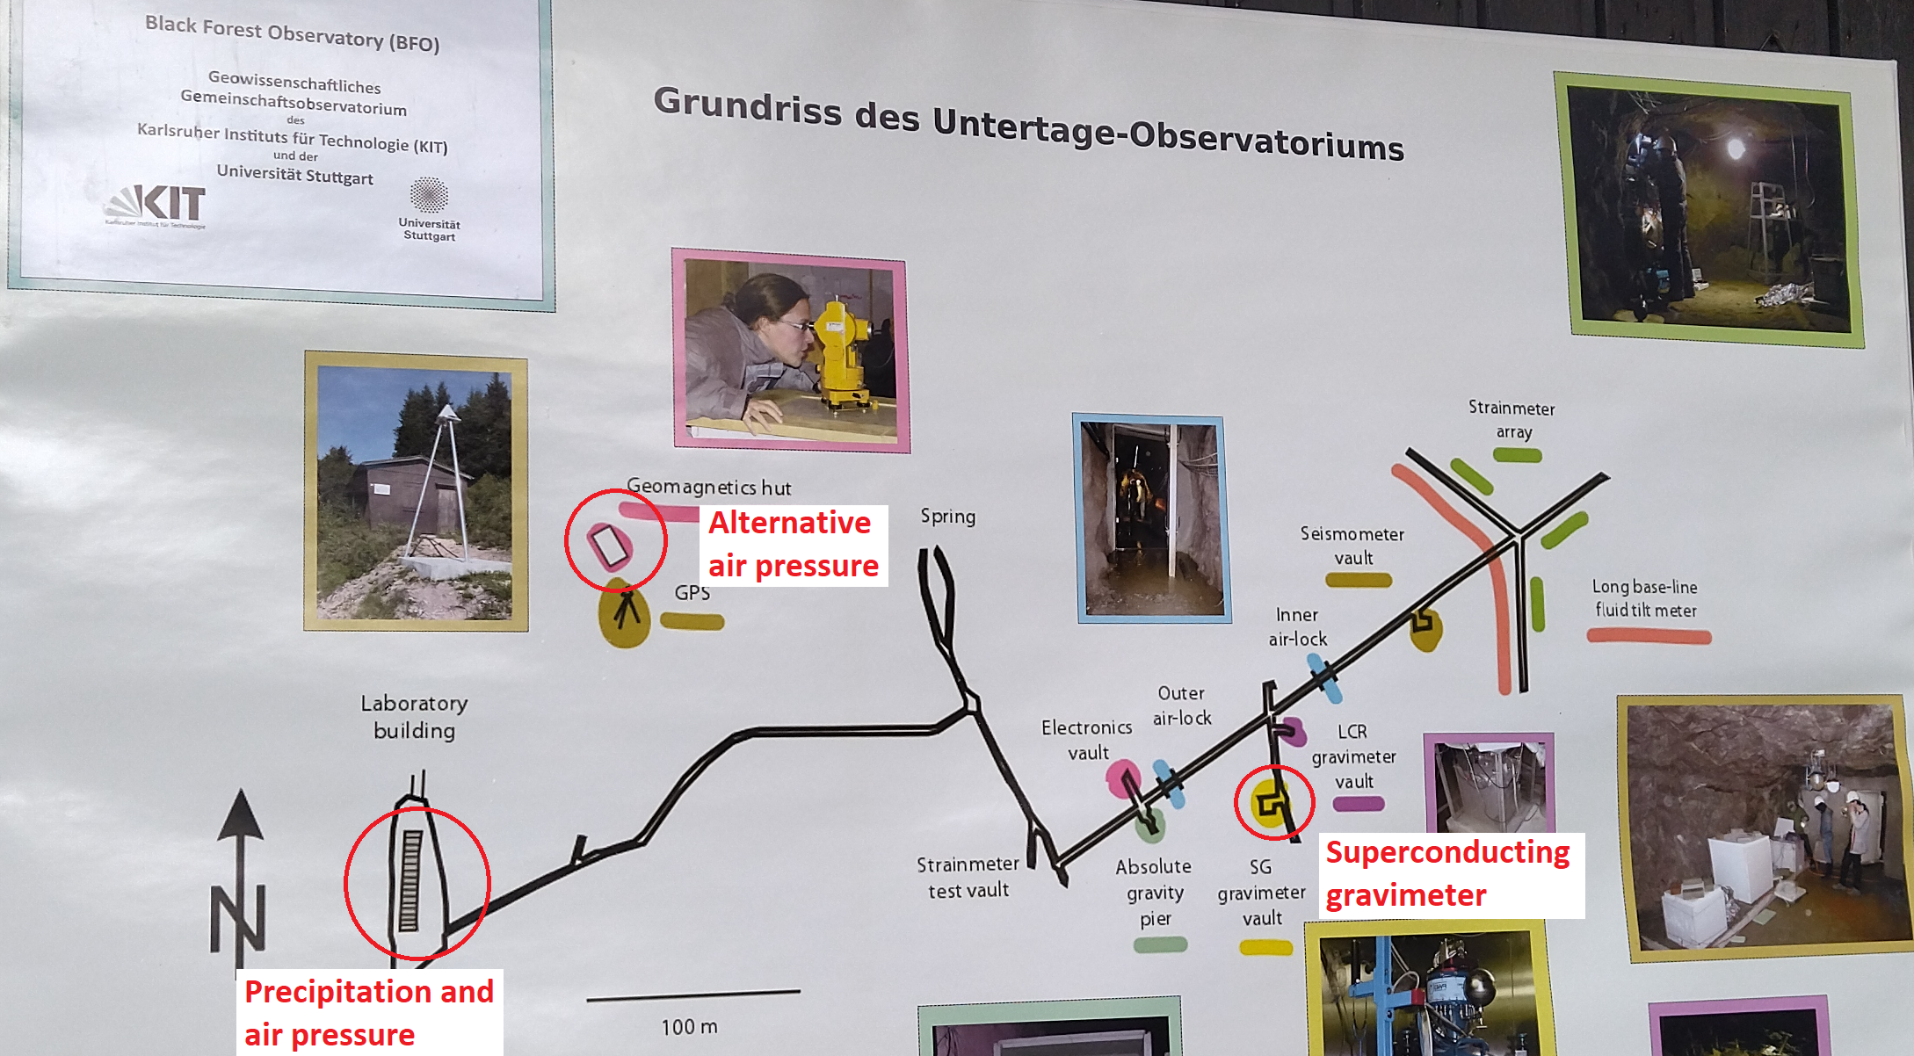
Measurement site
Fig. 2: Layout of the BFO (own picture)
SG in an old silver and cobalt mine
About 100 m under the surface
Notes:
-BFO is at the edge of a valley with a small creek, SG about 500 m inside mountain
-Stable temperature of around 8°C inside, air locks provide fairly stable pressure
-Not included in graphic are soil moisture probes

Slide 4
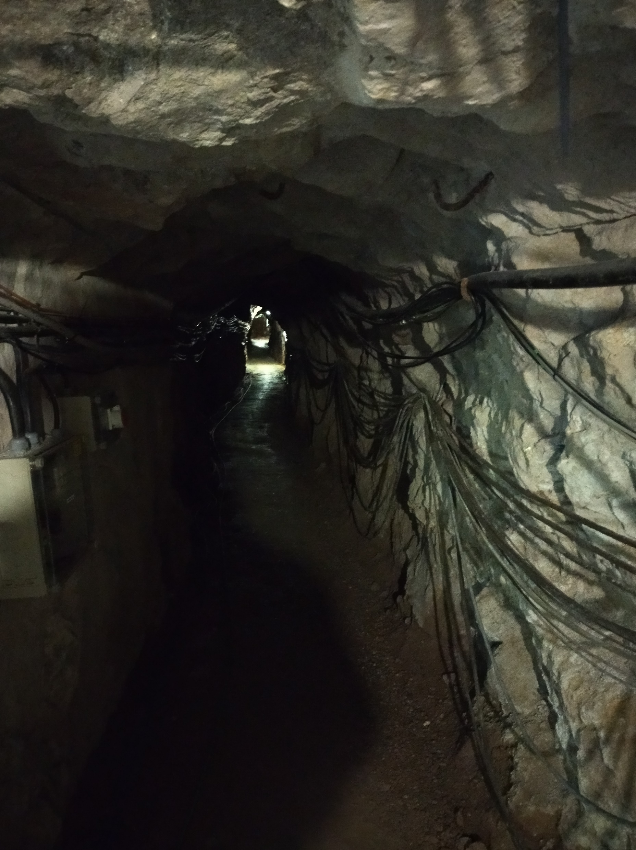
Measurement site
Fig. 3: Tunnel of the mine (own picture)
Notes:
- One of the cables connect SG and outside pressure gauge

Slide 5
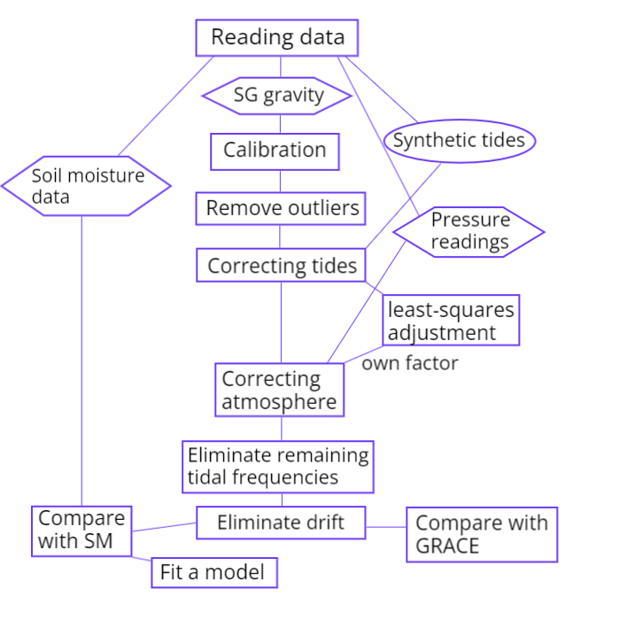
Workflow

Slide 6
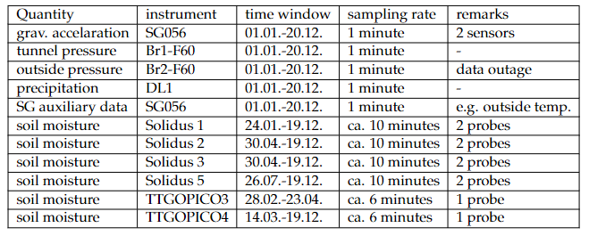
Data
Fig. 4: Overview of available data
All data are from 2022
Two sensors of the superconducting gravimeters SG056 – G1-F60 and G2-F60, vertical offset of 20 cm between them
Notes:
- RELATIVE measurements of gravity!

Slide 7
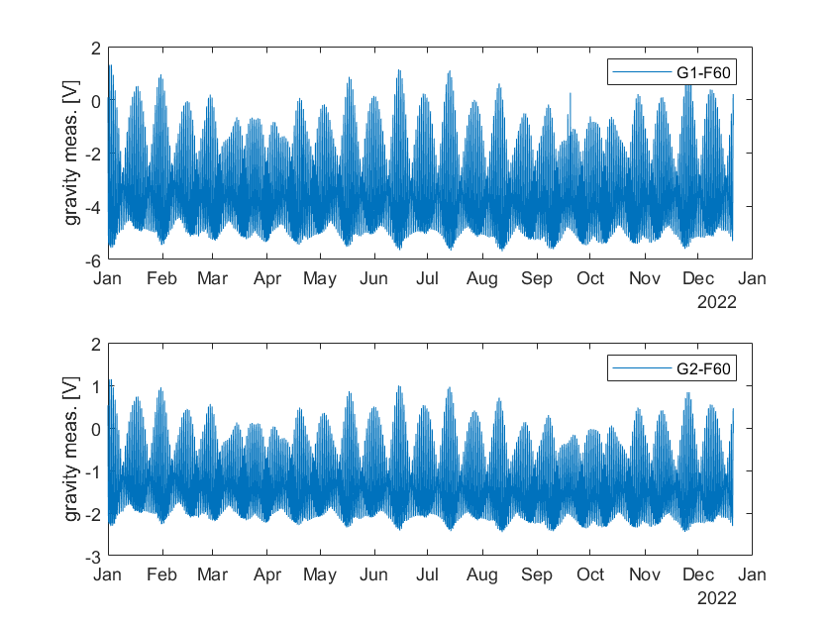
Data
Fig. 5: Uncalibrated gravity measurements of both sensors
Notes:
Outliers at G1-F60 in September
Different magnitudes of voltage

Slide 8
Calibration

Slide 9
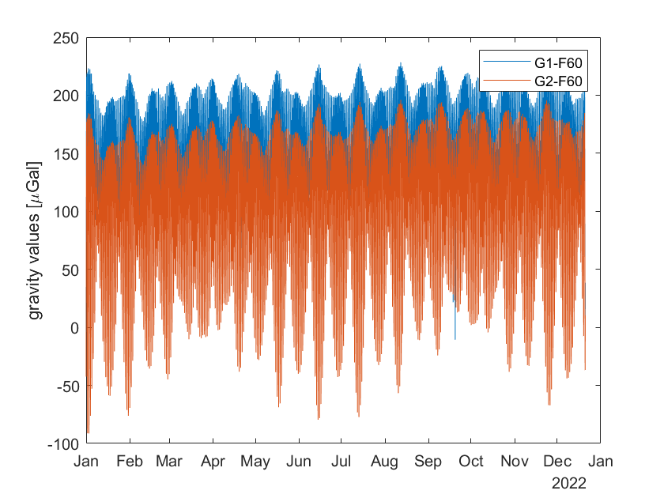
Calibration
Fig. 6: Calibrated measurements of both sensors
Given calibration coefficients for both sensors

Slide 10
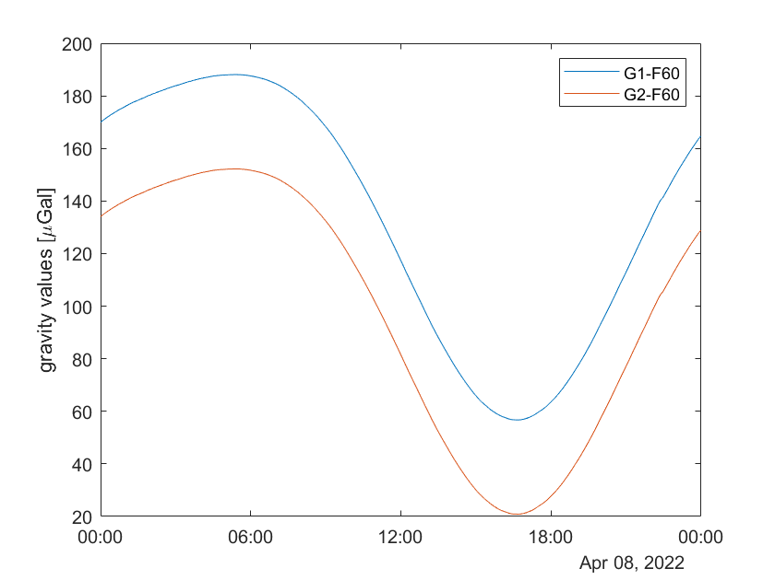
Calibration
Fig. 6: Calibrated measurements on April 8th

Slide 11
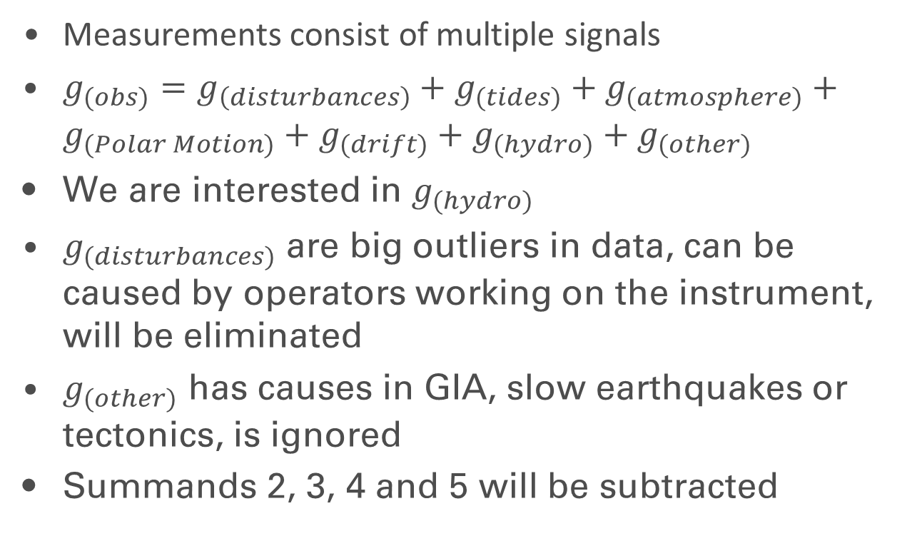
Corrections
Measurements consist of multiple signals
$g_{(obs)}=g_{\left(disturbances\right)}+g_{(tides)}+g_{(atmosphere)}+g_{(Polar Motion)}+g_{(drift)}+g_{(hydro)}+g_{(other)}$
We are interested in $g_{(hydro)}$
$g_{(disturbances)}$ are big outliers in data, can be caused by operators working on the instrument, will be eliminated
$g_{(other)}$ has causes in GIA, slow earthquakes or tectonics, is ignored
Summands 2, 3, 4 and 5 will be subtracted

Slide 12
Corrections

Slide 13
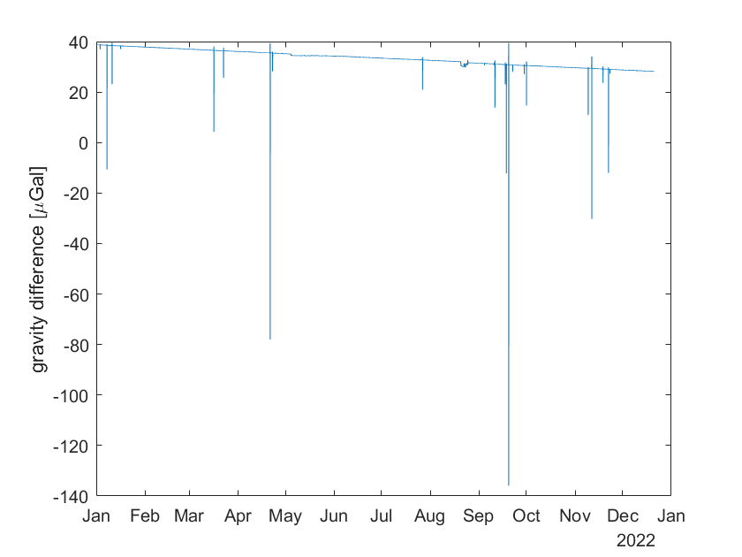
Removing outliers
Fig. 7: Differences between two sensors before outlier filtering

Slide 14
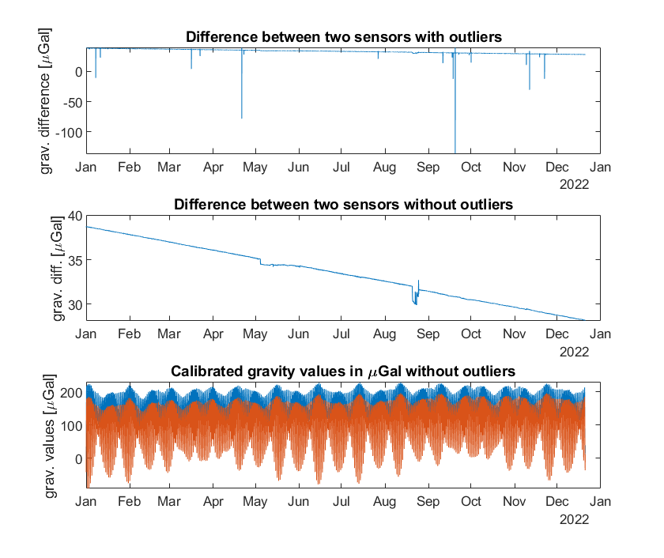
Removing outliers
Fig. 8: Removing outliers

Slide 15
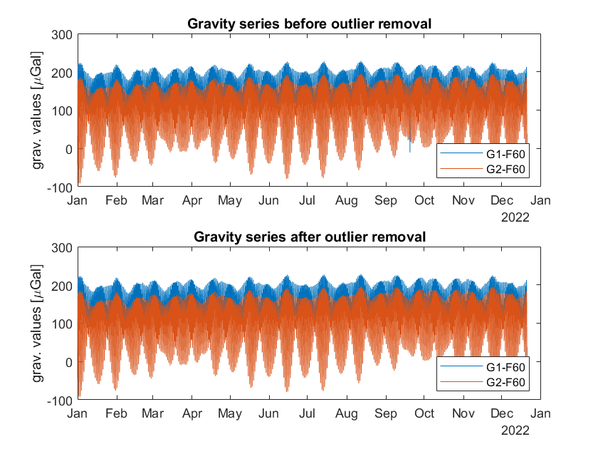
Removing outliers
Fig. 9: Comparison of gravity series before and after outlier removal

Slide 16
Tides

Slide 17
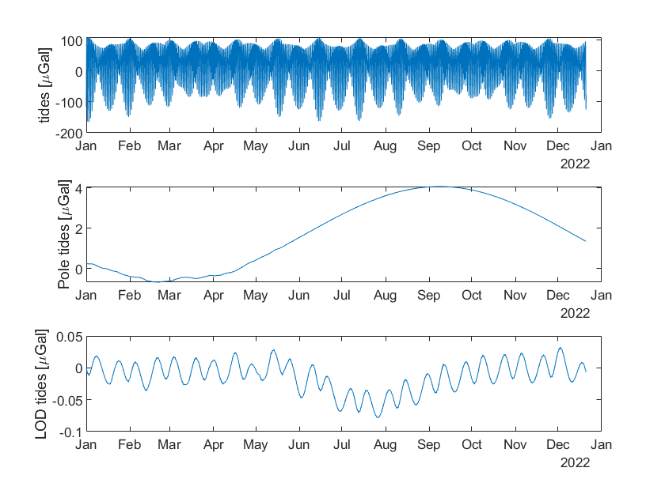
Tides
Fig. 10: Synthetic tides
Notes:
- Pole tide: Chandler period (400 days)

Slide 18
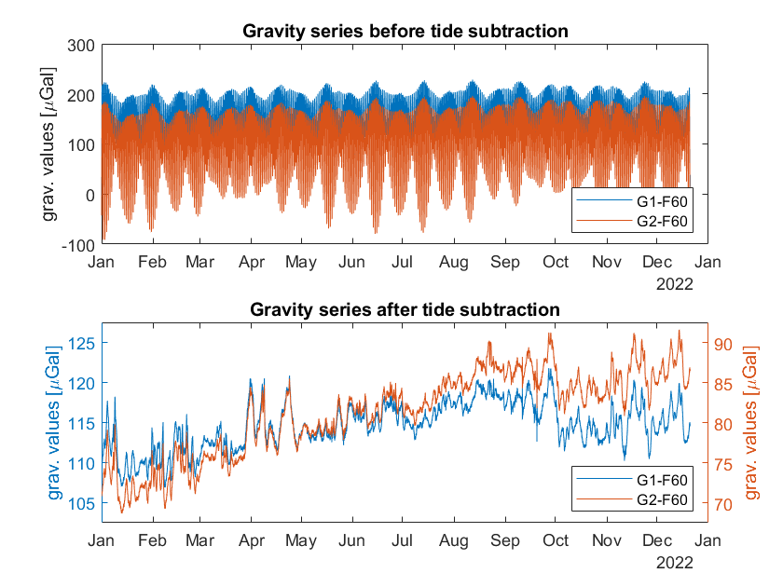
Tides
Fig. 11: Tide subtraction

Slide 19
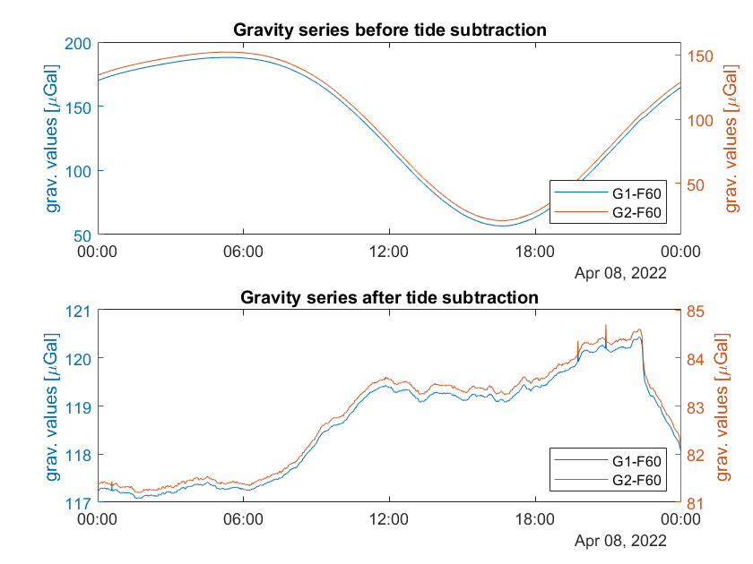
Tides
Fig. 12: Tide subtraction on Apr 8th

Slide 20
Atmospheric pressure

Slide 21
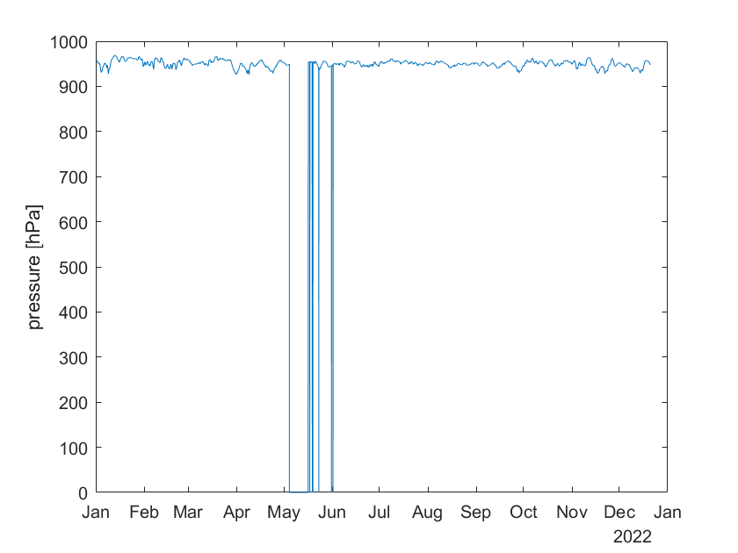
Atmospheric pressure
Fig. 13: Outside pressure series over the year
Notes:
- Data gaps because of interrupted connection between SG and pressure gauge after a storm

Slide 22
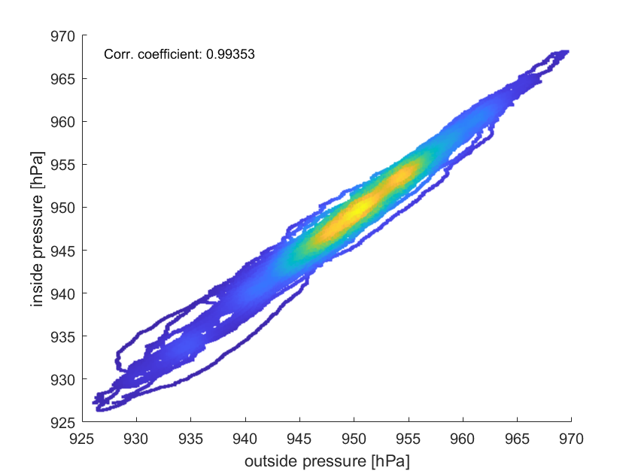
Atmospheric pressure
Fig. 14: Density scatter plot between inside and outside pressure

Slide 23
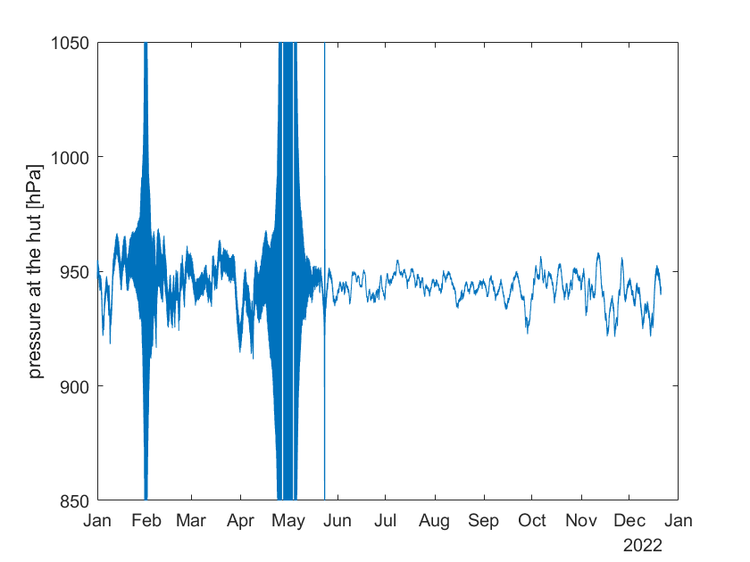
Atmospheric pressure
Fig. 15: Pressure series at the hut

Slide 24
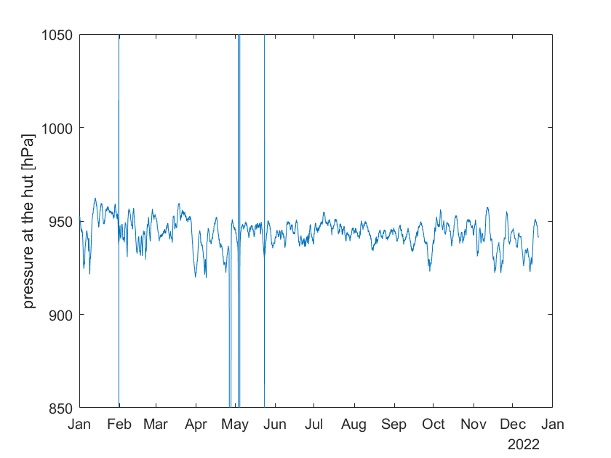
Atmospheric pressure
Fig.16: Pressure series at the hut after filtering

Slide 25
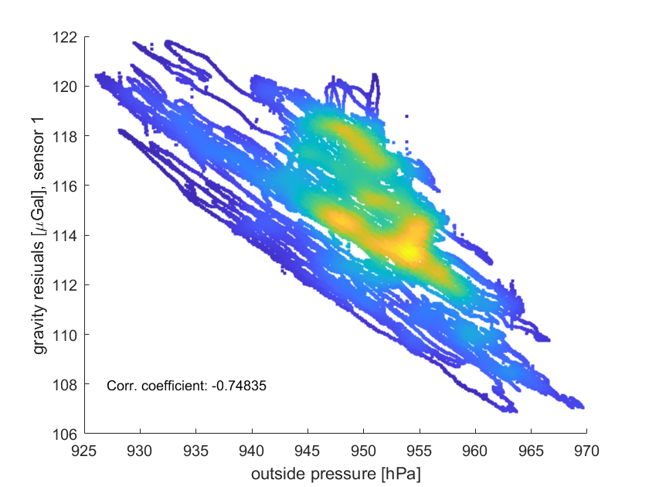
Atmospheric pressure
Fig. 17: Density scatter plot between outside
pressure and gravity residuals
Notes:
- Mention correlation coefficient

Slide 26
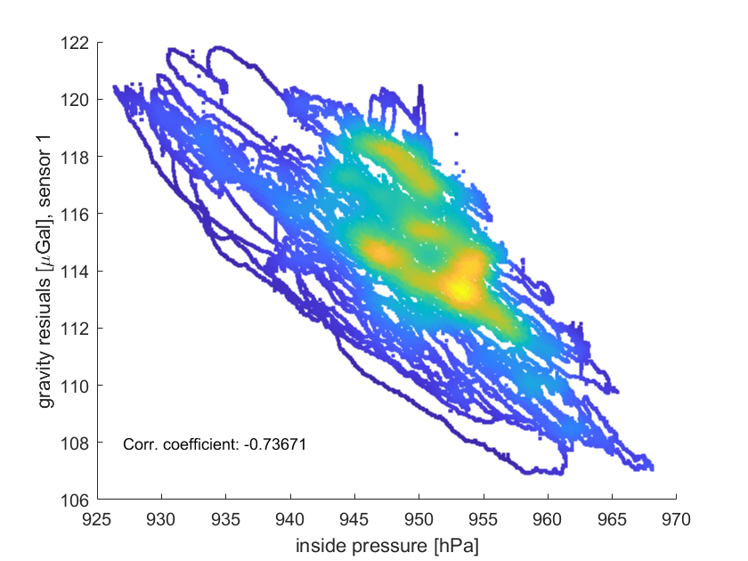
Atmospheric pressure
Fig. 18: Density scatter plot between inside
pressure and gravity residuals
Notes:
- Mention correlation coefficient

Slide 27
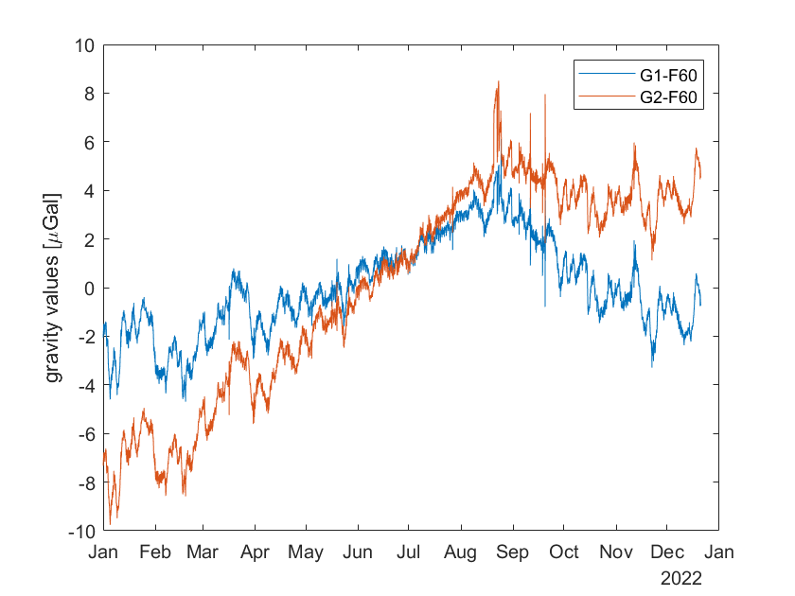
Atmospheric pressure
Fig. 19: Gravity residuals after pressure correction, gaps filled
by inside pressure

Slide 28
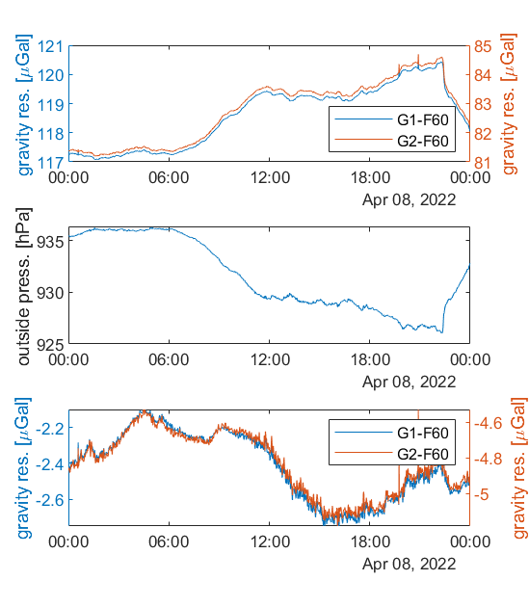
Atmospheric pressure
Fig. 21: Gravity residuals on April 8th before and after atmospheric correction

Slide 29
Atmospheric factor

Slide 30
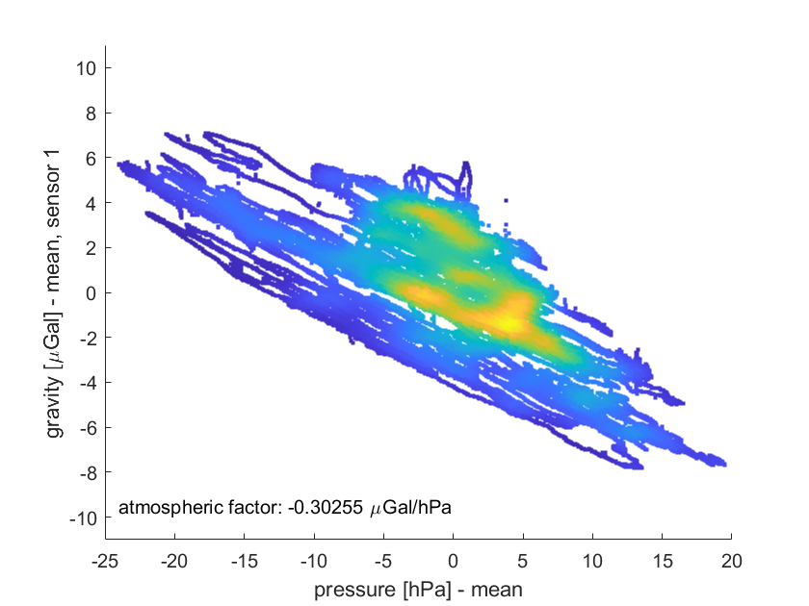
Atmospheric factor
Fig. 22: Density scatter plot between outside pressure and gravity residuals of sensor 1, without drift correction

Slide 31
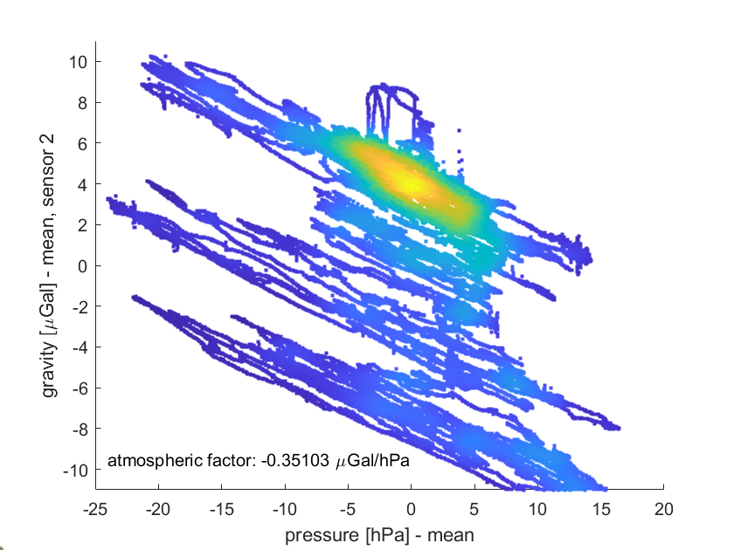
Atmospheric factor
Fig. 23: Density scatter plot between outside pressure and gravity residuals of sensor 2, without drift correction

Slide 32
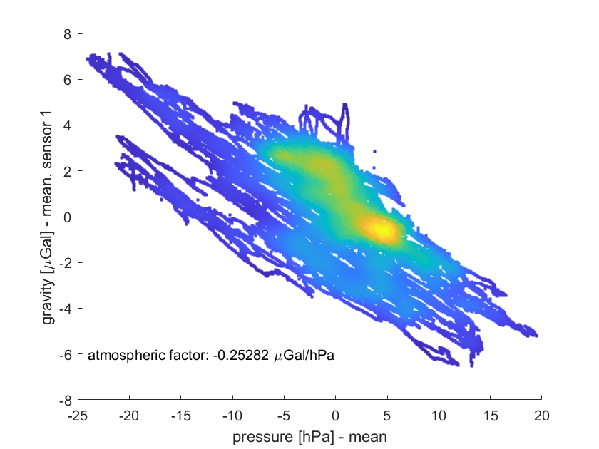
Atmospheric factor
Fig. 24: Density scatter plot between outside pressure and gravity residuals of sensor 2, with drift correction

Slide 33
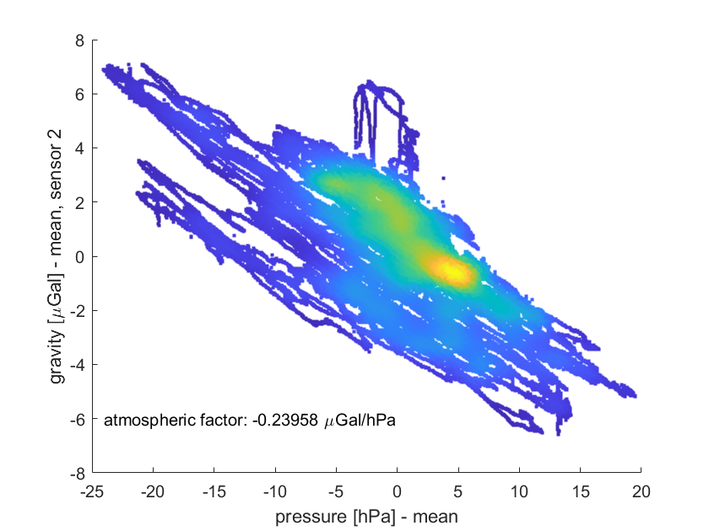
Atmospheric factor
Fig. 25: Density scatter plot between outside pressure and gravity residuals of sensor 2, with drift correction

Slide 34
Remaining frequencies

Slide 35
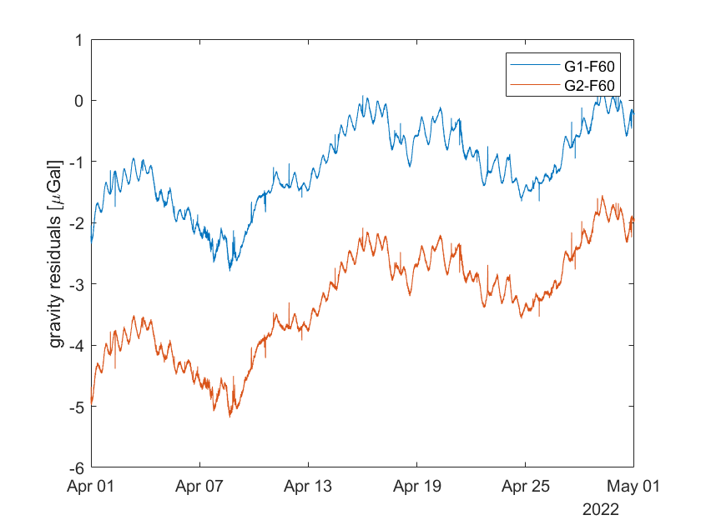
Remaining frequencies
Fig. 26: Gravity residuals of both sensors in April after removing atmospheric influence
Notes:
Frequencies with small amplitudes, especially tidal, are still visible
Load tides are not removed perfectly, parameters were estimated for a longer period

Slide 36
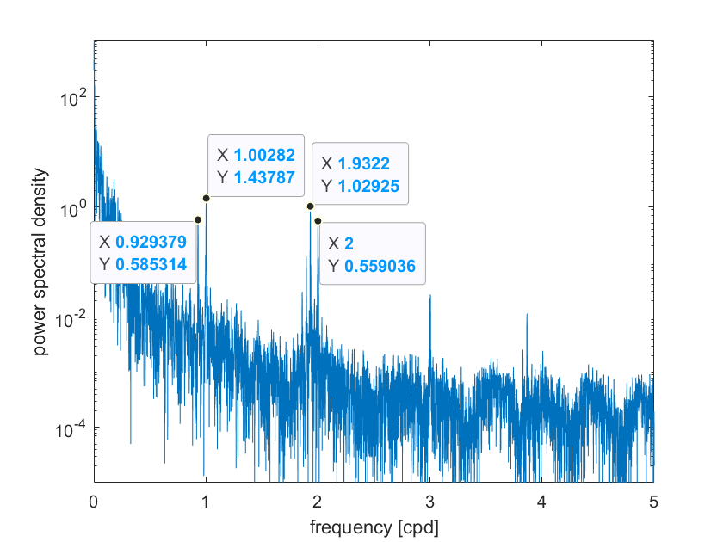
Remaining frequencies
Fig. 27: Lomb-scargle analysis of gravity series of sensor 1, biggest peaks marked
Lunar day = 0.966 cpd, half lunar day = 1.933 cpd

Slide 37
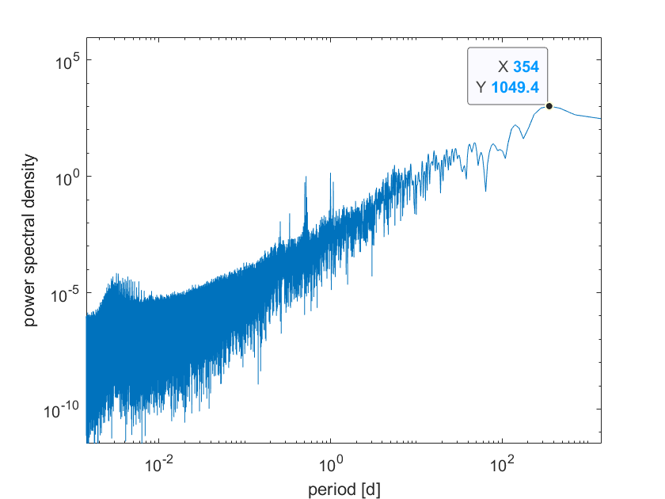
Remaining frequencies
Fig. 28: Full Lomb-scargle analysis for sensor 1
Notes:
- Inverse Depiction!!!

Slide 38
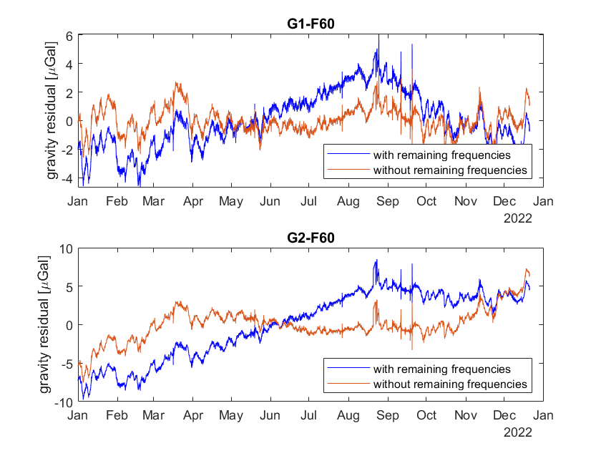
Remaining frequencies
Fig. 29: Gravity series before and after frequency elimination
Eliminated frequencies: 354 days, 1 day, 1 lunar day, ½ day, ½ lunar day

Slide 39
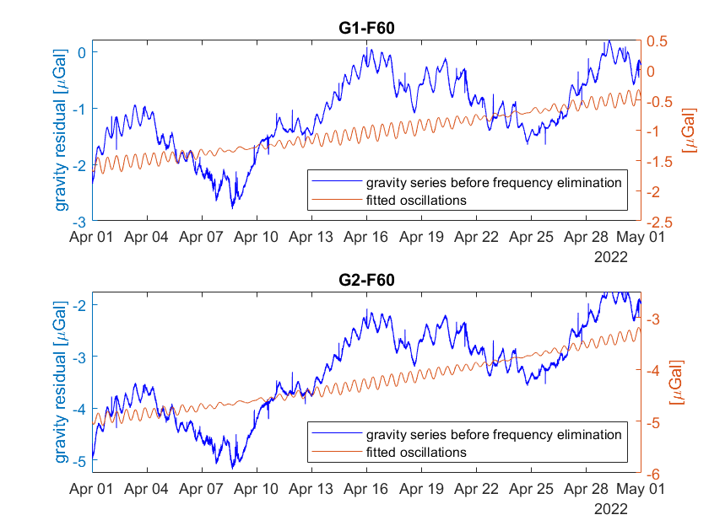
Remaining frequencies
Fig. 30: Fitted Oscillations in April

Slide 40
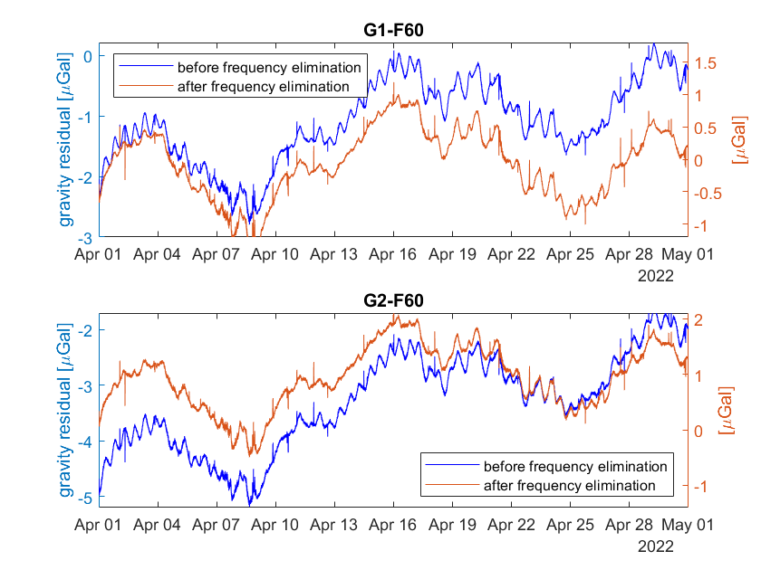
Remaining frequencies
Fig. 31: Comparison of gravity series before and after frequency elimination

Slide 41
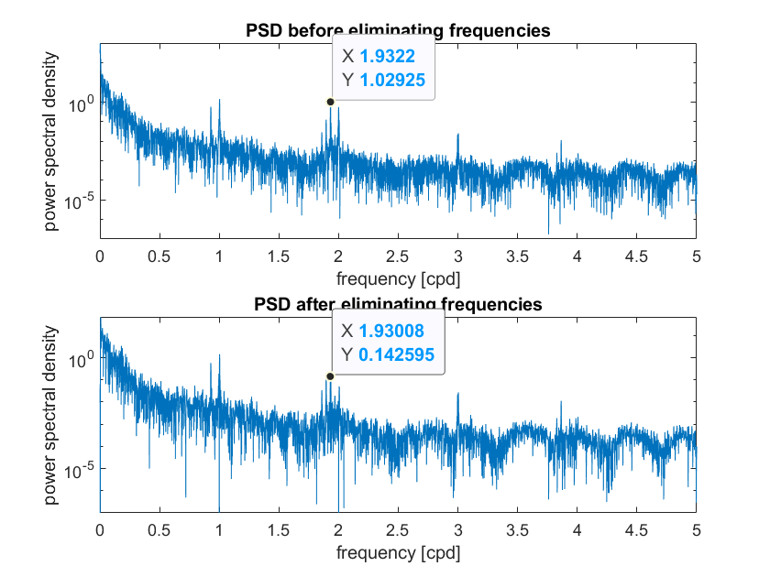
Remaining frequencies
Fig. 32: Comparison of PSDs before and after frequency elimination

Slide 42
Remaining frequencies

Slide 43
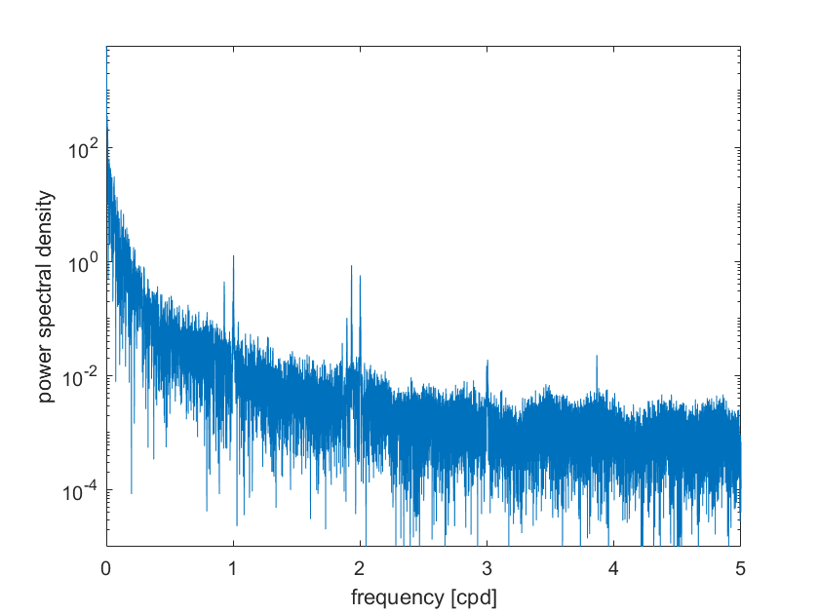
Additional slides
Fig. 27: Lomb-scargle analysis of gravity series of sensor 2

Slide 44
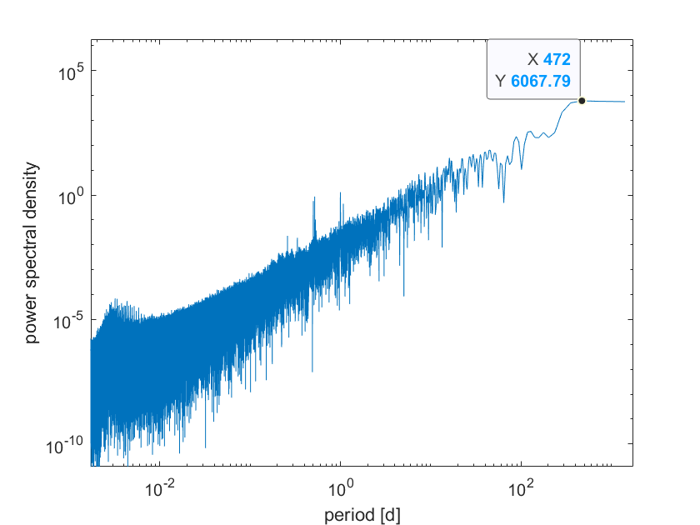
Additional slides
Fig. 28: Full Lomb-scargle analysis for sensor 1

